Slide 1
Software Measurement
“There’s no sense in being precise when you don’t even know what you’re talking about.”
-- John von Neumann
Notes:
Quantitative approach ~ Engineering

Slide 2
Motivation
"I often say that when you can measure what your are speaking about, and express it in numbers, you know something about it; but when you cannot measure, when you cannot express it in numbers, your knowledge is of a meager and unsatisfactory kind; it may be the beginning of knowledge, but you have scarcely in your thoughts advanced to the stage of science, whatever the matter may be."
--Lord Kelvin (19th century British scientist)
Obligatory quote whenever discussing measurement
“Without data, you are just another schmoe with an opinion.”
--Unknown (21st Century)
Modern-day translation
Notes:
Let me translate that for you…
Others:
“What gets measured, gets done.”
"You can't control what you can't measure.“ -- [Demarco 82]
“What you get is what you measure.” (If you measure LOC; you are going to get LOC.)
"In God we trust; all others must bring data.“ –Unknown
We discussed project control and quality control; both are heavily dependent on measurement.
“It is the mark of an instructed mind to rest satisfied with the degree of precision which the nature of a subject admits, and not to seek exactness when only an approximation of the truth is possible.” --Aristotle (330 BCE)
You won’t find exact measures of complexity, usability, maintainability, etc.

Slide 3
Motivation [Cont.]
Measurement is an important tool for understanding and managing the world around us.
Using quantitative data to make decisions
Familiar examples of the application of quantitative data:
  Shopping for stereo equipment
  Evaluating companies and making investment decisions
  Nutrition labels on food
  Engineering
Notes:
There are probably companies that have been bought based solely on their financials maybe without even a visit to a storefront.

Slide 4
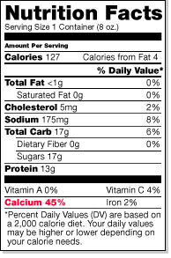
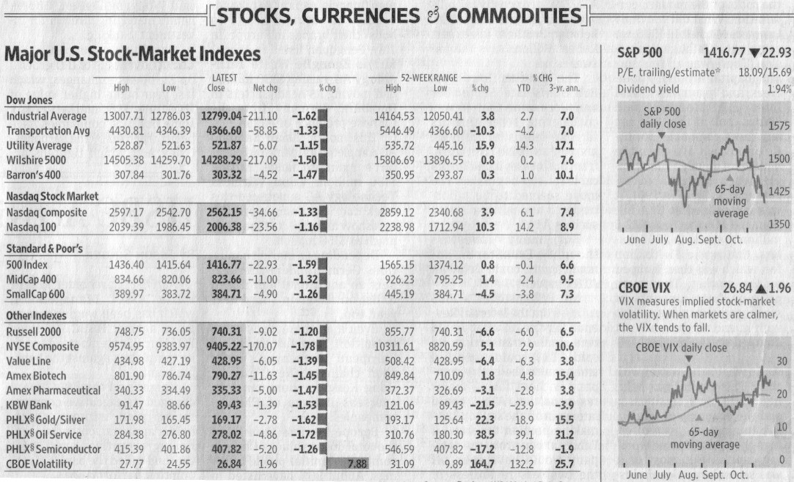
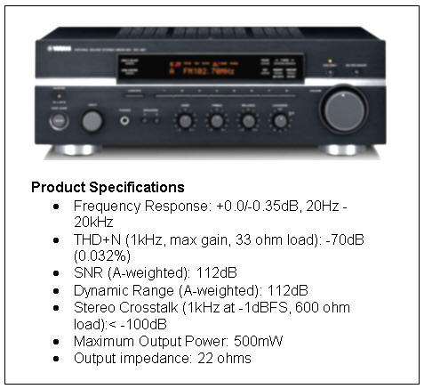
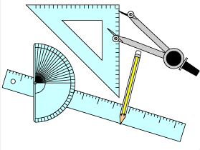
Familiar Metrics
Notes:
Aggregate financial measures such as the Dow Jones Industrial Average are important for understanding the economy as a whole. The economy as a whole is too large and complex to judge by antidotal evidence. Just because you paid more for a cup of coffee this morning doesn't mean inflation in the economy as a whole is on the rise. Financial numbers aggregate the numerous transactions that occur each day to provide a true picture of the state of the economy.

Slide 5
Measurement is fundamental to progress in…
Science
Business
Engineering
…just about every discipline
Measures provide data which yield information which leads to better decisions.
Notes:
Measurement is fundamental to progress in science, business, engineering—nearly all disciplines.
We use measurements such as MPH to set standards for safe driving.
Ben Bernanke (chairman of the federal reserve) looks at the numbers coming from the economy and decides short-term interest rates.
We measure ocean and atmospheric temperatures over time to detect changes in earth’s average temperature. From the data we get information: the world is experiencing global climate change. With this information we can make informed decisions.
The same can be true for software projects. Measures provide data which (begets,produces) information which leads to better decisions.
On a software project, collect data: LOC, defects, time between integrations, time needed to stabilize a build. Information: the cost of implementing a feature is 5% less when practicing frequent integrations. Decisions: daily integrations are new team policy.

Slide 6
Software Metrics Support…
Estimation
Project status and control
Visibility in general
Product quality
Process assessment and improvement
Comparison of different development approaches
Notes:
This lecture is divided into two parts: Measurement and Estimation.
Over time the data collected can improve your ability to estimate the cost and duration of new projects

Slide 7
Benefits of a quantitative approach
Software metrics support
  Estimation
  Planning
  Project Visibility and Control
  Quality Control
  Process Improvement
  Evaluating Development Practices
Notes:
Tbd: combine this slide with the previous
Role of software metrics. Why measure?
Software metrics are good for overall planning, visibility, understanding, and control.
Measurement provides a window onto the software development process. Measurement is the foundation for controlling and improving software development. The Federal Reserve Chairman looks at the inflation rate and other numbers and decides whether or not to change interest rates (a form of controlling the economy). A software project manager looks at defect rates and decides when to release a product.
Measurement helps you make better predictions in the future about software costs/schedule/quality.
Measurement helps justify and recommend new technologies, tools and methodologies. Do the benefits of code inspections outweigh their costs? Do code inspections follow an 80/20 rule? That is, does 80% of the benefits of code inspections come from 20% of the inspections? (i.e. do we really need to inspect all work products?)
Estimation – estimate the size of an upcoming project, compare it with other similar projects in the past including performance on these past projects (productivity – more metrics) in order to estimate cost and duration of future project.
Planning – estimates are the foundation for planning.
Control – measurements tell how close you are to plan.
Quality control – measurements inform when action is needed to meet quality goals.
Process Improvement – Metrics/Measurement can be used to optimize the development process.

Slide 8

Types of Software Metrics
Project Management
  Product Size (e.g. LOC) (If you are going to measure
  LOC created you should also measure LOC destroyed.
  May also want to measure LOC reused, LOC modified.
  Effort
  Cost
  Duration
Product Evaluation
  Product Quality (e. g. Number of defects, Defect density, WTFs/Min)
  Product acceptance (e.g. user satisfaction: content, delighted, etc.)
  Code Complexity (e.g. cyclomatic complexity)
  Design Complexity
Process Assessment and Improvement
  Process Quality (e.g. Defect removal efficiency)
  Development productivity (e.g. LOC/hr)
  Defect patterns (i.e anti-patterns. e.g. unused variable, disabled code, etc)
  Code coverage during testing
  Requirements volatility
  Return on investment (ROI)
Notes:
Merge these metrics in with the ones above:
• Number of use cases or requirements implemented
• Number of requirements changed.
• Number of test cases developed.
• Code inspection and review statistics.
Could add organization decision-making:
Revenue, expense, return on Investment
Things that can be counted during a project.
Three categories of metrics: project, product, and process.
Defect density = number of errors found per unit of product during a certain type period.
Example 1: During this code review we found 20 errors per KLOC.
Example 2: Starting with system test running through the first year after release 15 defects per KLOC were found.
Defect density can be used to:
Measure process effectiveness or quality
Identify error-prone modules
De

Slide 9
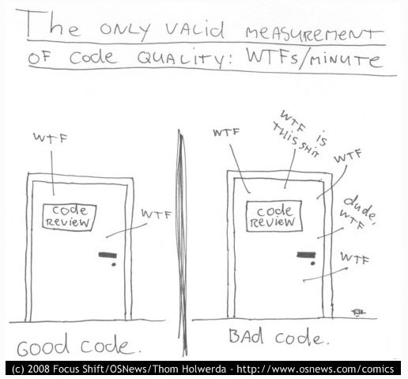
Notes:
WTF = Well That looks Funny (or, Where’s the Fudge?)
Cartoon by Thom Holwerda.
Ref: http://www.osnews.com/story/19266/WTFs_m

Slide 10
Six Core Metrics
Size (LOC, Function points, use cases, features)
Effort
Cost
Duration
Productivity = size / effort
Quality
Notes:
TBD: Not surprising. These cover the 4 variables of a project. Cost is basically effort and productivity is a composite measure.

Slide 11
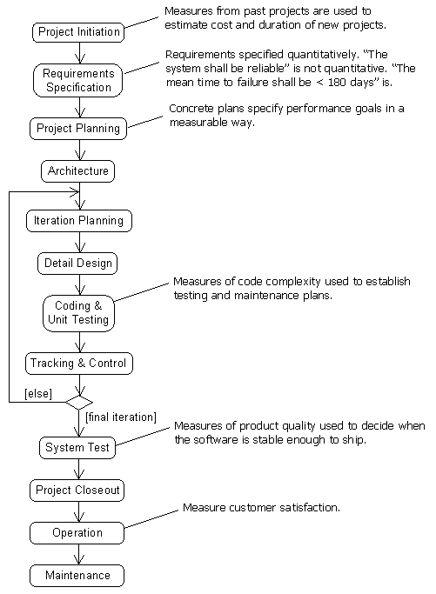
Opportunities for measurement during the software life cycle

Slide 12
Subjective and Objective Measures
A subjective measure requires human judgment. There is no guarantee that two different people making a subjective measure will arrive at the same value.
  Example: defect severity, function points, readability and usability.
An objective measure requires no human judgment. There are precise rules for quantifying an objective measure. When applied to the same attribute, two different people will arrive at the same answer.
  Example: effort, cost and LOC.

Slide 13
Measure
Measure – the magnitude of a quantity relative to a standard. “5 feet” is a measure. It expresses a quantity that is 5 times that of the standard foot, which is 0.3048 meters.
Measures by themselves aren’t very useful. “5 feet” has little informational value. Except in pedantic definitions like this one, measures are used to quantify the attributes of entities. For example, “5 foot reef shark” describes the length attribute of a reef shark entity.
An entity can be a product (such as code, requirements document, etc.), a resource (including people), a process (such as an inspection, testing, etc.) or a project.
An attribute is a property or characteristic of an entity. For example, attributes of source code include size, complexity and modularity. Attributes of the system test process includes time, effort and number of issues reported.
Measuring attributes of software entities can be a bit of a challenge because there aren’t standard units of measure for some of the attributes we would like to quantify. For example, the statement “the length of this module is 5 LOC” is imprecise because there is no standard definition for a line of code.
Notes:
TBD: Great summary of measurement terms in chapter 6 of Software Engineering: Principles and Practices. I need to incorporate that here.
Concepts and terminology
From ASQ Certification exam study topics: “Apply appropriate measurement scales (nominal, ordinal, ratio, interval) in various situations.”
(TBD: “Measurement of some attribute of a set of things is the process of assigning numbers or other symbols to the things in such a way that relationships of the numbers or symbols reflect relationships of the attributes of the things being measured. A particular way of assigning numbers or symbols to measure something is called a scale of measurement.“ “Measurement theory helps us to avoid making meaningless statements. A typical example of such a meaningless statement is the claim by the weatherman on the local TV station that it was twice as warm today as yesterday because it was 40 degrees Fahrenheit today but only 20 degrees yesterday. This statement is meaningless because one measurement (40) is twice the other measurement (20) only in certain arbitrary scales of measurement, such as Fahrenheit. The relationship 'twice-as' applies only to the numbers, not the attribute being measured (temperature). ” ftp://ftp.sas.com/pub/neural/measurement.html)
We don’t have standard units for all the quantities we would like to measure. Maybe we need to deposit one line of code from Linus Torvalds with the National Institute of Standards and Technology. Then when we say a module is 4 LOC we will have a standard for comparison.
Tbd: http://books.google.com/books?id=nG2UShV0wAEC&pg=PA28&lpg=PA28&dq=subjective+objective+measures+software&source=bl&ots=9FgdPS0kZd&sig=nM2U9r7rlkr7ghAaJq1227up8_k&hl=en&ei=Q-7jSrioGpy-swOSgNGwBA&sa=X&oi=book_result&ct=result&resnum=5&ved=0CCEQ6AEwBA#v=onepage&q=subjective%20objective%20measures%20software&f=false
http://standards.computer.org/sesc/s2esc_pols/FP-05_Software_Measurement.htm
http://www.socialresearchmethods.net/kb/measlevl.php
http://www.stsc.hill.af.mil/crosstalk/1995/03/Measure.asp

Slide 14
Metric
Metric – a quantitative measure of the degree to which an entity possesses a given attribute.
A standard unit of measure, such as hours, or a measure such as 5 hours are both metrics.
Example software metrics: the number of hours it takes to complete a task, the number of lines of code in a module, defect density.
Note, some metrics are base or single-valued measures: hours worked, LOC, cyclomatic complexity. Others are derived from one or more base measures. For example, defect density is defects per KLOC, maintainability is a function of many factors including complexity, size, percentage of source lines of code that are comments, etc.
Notes:
The terms measure and metric are sometimes used interchangeably. There is a subtle difference between the two terms though.
The term metric is generally used when referring to a standard way of measuring some attribute. For example, at the start of a project you might debate whether LOC or function points is a better metric for measuring product size. During the project you would take measurements, i.e. “this module is 40 LOC”. 40 LOC is a measurement.
Once you decide on a metric, “let’s use LOC to quantify product size,” then you can begin to take measures. You decide on metrics before a project and take measures during a project.

Slide 15
Levels of Measurement
Nominal – a nominal measure maps objects to mutual exclusive, but not ordered, categories.
Ordinal – an ordinal measure rank orders objects.
  Example: defect severity.
Interval – an interval measure
  Example:
Ratio –
  Example:
Notes:
Is scale type a better title?
See page 442 in Return on software. It describes types of measures.
See: http://www.socialresearchmethods.net/kb/measlevl.php
http://www.graphpad.com/faq/viewfaq.cfm?faq=1089
http://courses.csusm.edu/soc201kb/levelofmeasurementrefresher.htm
Before you can compare two or more things you have to decide on the attributes or criteria for comparison. Attributes for comparing people: years of experience, years of education, languages known, etc. Attributes for comparing programs: defect density, LOC, cyclomatic complexity, etc. Attributes for a computer: CPU speed, memory, reliability, noise level, etc. Measurement is motivated by the need for better understanding. You want to pick attributes or criteria that will serve the purpose of the measurement. For example the color of the computer might or might not be a good attribute or criteria for assessing a computer. If the computer will be installed in the public area of a design studio it most likely will be. If it will be used in back-office processing, color isn’t a meaningful/useful attribute.
There are differnet types or classes of measures. It’s important to distinguish between the types because differnet classes or types of measures support differnet types of operations. For example, if you measure the size of a beverage class by ml, you can say that a 4 ml glass is twice the size of a 2 ml glass. If you measure by: small, medium, large, you can’t say that a small glass is 1/3 the size of a large glass. It’s important to understand the different types of measures and what operations are valid on each type.
There are different types of measures, some more powerful than others. For example, you could choose to quantify the size of modules as small, medium or large (an ordinal measure). Alternately you could quantify module size using an integer value which is the number of lines of code (a ratio scale). Using a radio scale you can make more precise comparisons between modules. You might say, module A is 28% larger than module B. There is less power with an ordinal scale. Best case, you are limited to saying module A is larger than B. Worst case module A wasn’t big enough to be bumped to a large category. You might be limited to saying they are roughly the same size.
Measurements can be classified into different scale types. types of scale.
Some scale types are more powerful than others.

Slide 16
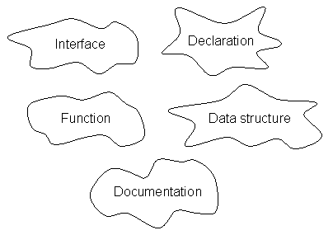
Nominal Scale
“A nominal scale only shows categories of things.”
Notes:
Permitted/valid operations on values: classification, equality and inequality among values.
“used for classification only” You can’t compare values based on nominal scale attributes. For example, it doesn’t make sense to say that an imperative language is greater than / easier / etc than a declarative language. “Can’t be used as a basis for comparison between alternatives.” [return on s/w]
A nominal attribute simply tells you want category a value is in.
“there isn’t necessarily a meaningful ordering among the values in a nominal scale.”
Example: type of language:
Declarative
Imperative
Example: defect type: documentation, declaration, interface, data structure, function, etc.

Slide 17
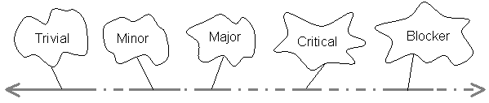
Ordinal Scale
“An ordinal scale puts the categories into a particular order.”
Notes:
Example: Starbucks uses the terms: Short, Tall, Grande and Venti.
“There is an order, or ranking, to the values in the measure.”
Example: CMMI process maturity rankings: 1, 2, 3, 4 and 5. Even those these are numeric, a 4 doesn’t imply the organization has a process that is twice as good one rated a 2.
Operations: all those permitted for nominal scale plus order. You can say that one value is before or after another. If the scale use used to measure size you can say that one is bigger than another. If the scale is severity one can be more or less severe than another.

Slide 18
Interval Scale
Notes:
“The difference between the values have the same significance at all points on the scale.”

Slide 19
Goal—Question—Metric
Just collecting data is a waste of time unless the numbers are put to use.
Need a plan for turning data into information.
The proper order is:
  Goal – Define the problem you are trying to solve or opportunity you want to pursue. What are you trying to accomplish?
  Question – What questions, if answered, would likely lead to goal fulfillment?
  Metrics – What specific measures are needed to answer the questions posed?
Notes:
Now turn our attention to how to incorporate metrics.
Technique or framework for applying metrics
Goal: improved product quality.
Question: what is our current product quality? What types of errors are most common? When and how are these errors being introduced?
Metrics: Defect density (defects per KLOC), type and severity of defects, phase introduced, how found, software complexity, etc.
Goal: Decrease amount of manual testing
Question: What percent of code is covered by automated unit tests?
Metric: Statement coverage of automated unit tests
Measure in a purposeful way.
Also see: http://www.westfallteam.com/Papers/12_steps_paper.pdf. Linda Westfall describes 12 steps for creating a metrics program.
A metrics model defines the attributes you plan to measure and the relationships between these attributes. It shows how you transform base measures like LOC and defect counts into the information needed to answer questions and make decisions.

Slide 20
Potential Goals
Improved estimating ability (current and future projects)
Improved project control
Improved product quality
Improved understanding of evolving product quality
Improve development process (higher productivity)
Improved understanding of relative merits of different development practices
Notes:
TBD: I need to group example goals, questions and metrics by theme.
Better estimates (current and future projects)
Better control over projects
Better understanding of evolving product quality
Better understanding of process productivity and opportunity for process improvement
Better understanding of the relative merits of different development practices

Slide 21
Potential Questions
What is the difference between estimates and actuals on past projects (cost and duration)?
What is our current productivity?
What is the current level of quality in products we ship?
How effective our are defect removal activities?
What percentage of defects are found through dynamic testing verses inspections?

Slide 22
Potential Metrics
Size
  Lines of Code (LOC), Function Points, Stories, Use cases, System “shalls”
Effort (person months), Duration (calendar month)
Cost
Quality
  Number of defects (possibly categorized by type and severity)
  Defect density
  Defect removal efficiency
  Mean time to failure (MTTF)
  Defects per unit of testing (i.e. defects found per hour of testing)
  Quantification of non-functional attributes (usability, maintainability, etc.)
Code Complexity
  Cyclomatic complexity
Design Complexity (how to measure?)
Productivity (size / effort)
Requirements volatility (% of requirements that change)
Code coverage during testing
Return on Investment

Slide 23
Product Size Metrics
Having some way of quantifying the size of our products is important for estimating effort and duration on new projects, productivity, etc.
Example size metrics:
  Lines of Code (LOC)
  Function Points
  Stories, Use cases, Features
  Functions, subroutines
  Database Tables
Notes:
Productivity was one of our core metrics.
Productivity = product size (and quality) / effort

Slide 24
Size Estimate: Lines of Code
LOC is a widely used size metric even though there are obvious limitations:
  need a counting standard
  language dependent
  hard to visualize early in a project
  does not account for complexity or environmental factors
  encourages verbose coding
To steal a line from Winston Churchill: LOC is the worst form of software measurement except all the others that have been tried.
Notes:
Danger in using LOC as counting standard to measure productivity: you get what you measure. Gives wrong incentive.
Engineers working on the Apple Lisa computer in 1982 were asked to fill out a form each week to track progress by LOC written. Bill Atkinson had done some refactoring one week that eliminated 2000 lines of code so he entered -2000. After this he was never asked to fill out the form again.
Ref: http://www.folklore.org/StoryView.py?project=Macintosh&story=Negative_2000_Lines_Of_Code.txt
Advantages: understandable; objective; easy to count automatically.
When using LOC as a measure of product size, reusing code has the effect of lowering productivity. Favors verbose coding styles. For example, consider two programmers charged with implementing two similar features. They both take a month to complete the work. One reuses code and takes extra time to find a simple solution. The other "throws code" at the problem. The solution from the first programmer is 100 LOC with a productivity of 100 LOC/month. The solution from the second programmer is 1000 LOC with a productivity of 1000 LOC/month. The false conclusion is easy to see with this simple example.

Slide 25
Size Estimate: Function Points -1
Developed by Albrecht (1979) at IBM in the data processing domain and subsequently refined and standardised.
Based on system functionality that is visible from the user’s perspective:
  internal logical files (ILF)
  external interface files (EIF)
  external inputs (EI)
  external outputs (EO)
  external enquiries (EE)
Notes:
ILF – internal database file updated and maintained from user input
EIF – files necessary for system functionality but maintained external to the system. (EIF are ILF in the context of another system. Is this correct?)
EI – transactions that change ILF’s. For example, add, change and delete.
EO – outputs derived from ILF’s and EIF’s. Output may include derived data.
EE – outputs coming directly from ILF’s and EIF’s. There is no manipulation of data.

Slide 26
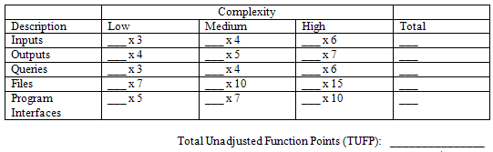
Size Estimate: Function Points -2
Unadjusted Function Points (UFP) – data functions are weighted by perceived complexity
Example: 4 * EI + 5 * EO + 4 * EE + 10 * ILF + 7 * EIF
Notes:
FP estimation requires judgment. ie estimating attribute weights, estimating system-wide complexity factors or weights.

Slide 27
Size Estimate: Function Points -3
There is also a Value Adjustment Factor (VAF) which is determined by 14 general system characteristics covering factors such as operational ease, transaction volume, distributed data processing.
The VAF ranges from 0.65 to 1.35

Slide 28
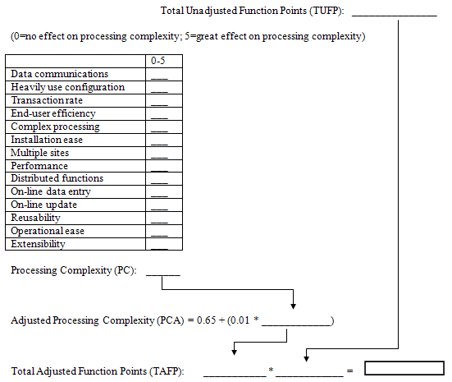
FP Template
Notes:
Ref: http://www.wiley.com/college/info/dennis241008/resources/Casebook/Templates/template03a.doc

Slide 29
Criticisms of Function Points
Counting function points is subjective, even with standards in place.
Counting can not be automated (even for finished systems, cf. LOC).
The factors are dated and do not account for newer types of software systems, e.g. real-time, GUI-based, sensors (e.g. accelerometer, GPS), etc.
Doesn’t account for strong effort drivers such as requirements change and constraints
There are many extensions to the original function points that attempt to address new types of system.
Notes:
Biased toward data processing types applications. Doesn't fit real-time systems well.
Managers and programmers are more accustomed to thinking in terms of LOC

Slide 30
Software Estimation
An estimate is a guess in a clean shirt.
--Ron Jeffries
Notes:
TBD: http://martinfowler.com/bliki/PurposeOfEstimation.html

Slide 31
Why Estimate?
At the beginning of a project customers usually want to know:
  How much?
  How long?
Accurate estimates for “how much?” and “how long?” are critical to project success.
  Good estimates lead to realistic project plans.
  Good estimates improve coordination with other business functions.
  Good estimates lead to more accurate budgeting.
  Good estimates maintain credibility of development team.
Notes:
Only about 25%-35% of projects meet their initial goals. A good portion of the projects that failed to meet their original schedule and budget goals probably started with poor estimates.
[Lederer and Prasad 1992: nine management guidelines for better cost estimating] 63% of large software projects significantly overran their estimates.

Slide 32
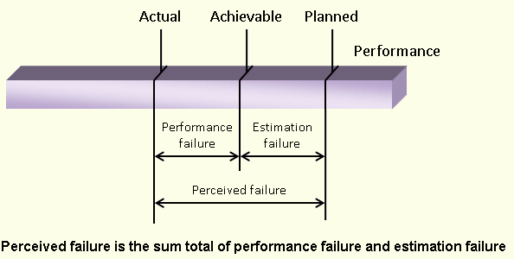
Estimation and Perceived Failure
Good estimates reduce the portion of perceived failure attributable to estimation failure

Slide 33
What to Estimate?
  System Size (LOC or Function points)
  Productivity (LOC/PM)
  Effort
  Duration
  Cost
How Long?
System Size
Duration
Effort
Productivity
Cost
How Much?
Notes:
Estimates are inputs for business decisions (where to invest, targets, etc.).
LOC/PM = lines of code per month
If target duration is less than estimated nominal duration, cost will increase. This makes final cost dependent on target duration (not nominal estimated duration).

Slide 34
Effort
Effort is the amount of labor required to complete a task.
Effort is typically measured in terms of person months or person hours.
The amount of effort it takes to compete a task is a function of developer and process productivity.
Productivity = LOC or function points (or unit of product) per month or hour.

Slide 35
Duration
Duration is the amount of calendar time or clock time to complete a project or task.
Duration is a function of effort but may be less when activities are performed concurrently or more when staff aren’t working on activities full time.

Slide 36
Distinguishing between estimates, targets and commitments (and wild guesses)
An estimate is a tentative evaluation or rough calculation of cost, time, quality, etc. that has a certain probability of being accurate.
A target is a desirable business objective.
A commitment is a promise to deliver a result at a certain time, cost, quality, etc.
A wild guess is an estimate not based on historic data, experience, sound principles and techniques
Notes:
Misunderstandings and confusion can result when the proper distinction isn’t maintained between estimates, targets and commitments.
Targets and commitments don’t have to be the same as the estimate. When targets and commitments are much more aggressive then the estimate there is more risk and the probability of meeting the target is much lower.
Don’t change the estimate to meet targets. It’s okay to plan and manage to aggressive targets, but estimates should maintain their own existence.
When someone asks for an estimate listen carefully. They might not be interested in an estimate so much as a plan for hitting a target. [McConnell 2006] “I need an estimate for how much it will cost to make the changes we discussed yesterday.” “Based on the information I have now, assuming all members on our current team can devote 100% of their time to the project, I estimate it will take 6 to 8 months to complete. Once the requirements are a little more certain I can give you a more precise estimate.” “That’s unacceptable. We need those changes made by the end of the second quarter. You have to do better than that.” This person doesn’t want an estimate. This person is desperate for a plan to hit a business target.
There are also bids. A bid is an estimate + profit margin (usually scaled according to risk).
There are also wild guesses. A wild guess is an estimate that is not based on sound principles and techniques.

Slide 37
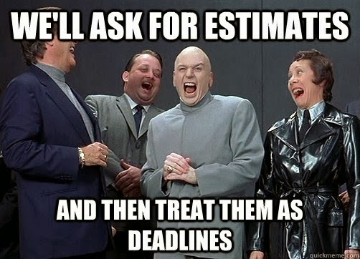
Be careful that estimates aren’t misconstrued as commitments
Notes:
Read in your best Dr. Evil accent…
Ref: http://mikehadlow.blogspot.com/2014/03/coconut-headphones-why-agile-has-failed.html

Slide 38
Probability distribution of an estimate
With every project estimate there is an associated probability of the estimate accurately predicting the outcome of the project.
Single-point estimates aren’t very useful because they don’t say what the probability is of meeting the estimate.

Slide 39
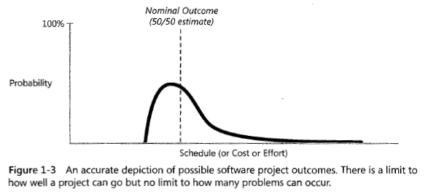
Probability distribution of an estimate
Notes:
Probability distribution of an estimate is not a bell curve [McConnell 2006]. Why might someone get the idea that an estimate does have probability distribution of a bell curve??
Estimates should include assumptions, risks and "certainty factors". Estimates should be updated as more information about the project is known.
Single point estimates are misleading. Never state an estimate without making its probability distribution clear. You can do that by stating a range rather than a precise number. You can do that by stating best, worst, and most likely case.

Slide 40
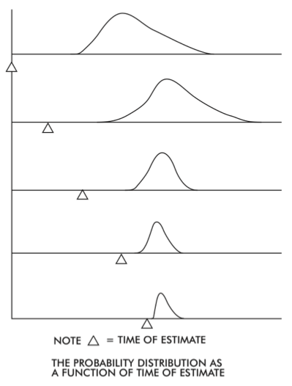
Notes:
From conference proceedings of 1968 NATO conference on Software Engineering.

Slide 41
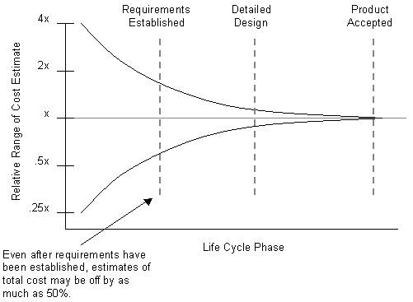
Cone of Uncertainty– by phase
Notes:
Have the estimates for what you plan to accomplish on your project become more certain and precise over time?
Uncertainty correlates with risk. At the beginning of a project there are significant risks associated with the people, product and process of the project. One of the main responsibilities of the project manager is to rapidly reduce risk and therefore the uncertainty associated with the project.

Slide 42
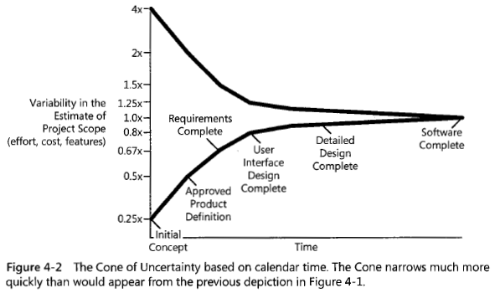
Cone of Uncertainty – by time
Notes:
It's difficult to give precise estimates of effort early in the project. Precision increases throughout the software life cycle. [Boehm 1981]
What does the green area represent? There is no guarantee the cone of uncertainty will narrow automatically. If effort isn’t put toward reducing risk and resolving requirements high uncertainty can remain in the project through development. If project scope and requirements change aren’t controlled uncertainty can widen later in a project.

Slide 43
How to Estimate?
Techniques for estimating size, effort and duration:
  Analogy
  Ask an Expert
  Parametric (algorithmic) models
Notes:
Ask an expert = Expert judgement

Slide 44
Estimating by Analogy
Identify one or more similar past projects and use them (or parts of them) to produce an estimate for the new project.
Estimating accuracy is often improved by partitioning a project in parts and making estimates of each part (errors cancel out so long as estimating is unbiased).
Can use a database of projects from your own organisation or from multiple organisations.
Because effort doesn't scale linearly with size and complexity, extrapolating from past experience works best when the old and new systems are based on the same technology and are of similar size and complexity.
Notes:
What, if anything, is wrong with the following logic? The next project is twice the size of the previous project. I estimate it will take twice the effort.
This is another reason for tracking estimates and actuals of tasks and activities. You will have smaller grained components with which to compare to new projects.

Slide 45
Estimating by Expert Judgment
Have experts estimate project costs possibly with the use of consensus techniques such as Delphi.
Bottom-up composition approach: Costs are estimated for work products at the lowest-levels of the work breakdown structure and then aggregated into estimates for the overall project.
Top-Down decomposition approach: Costs are estimated for the project as a whole by comparing top-level components with similar top-level components from other projects.
Notes:
Ask and Expert

Slide 46
Wide-band Delphi
Get multiple experts/stakeholders
Share project information
Each participant provides an estimate independently and anonymously
All estimates are shared and discussed
Each participant estimates again
Continue until there is consensus, or exclude extremes and calculate average

Slide 47
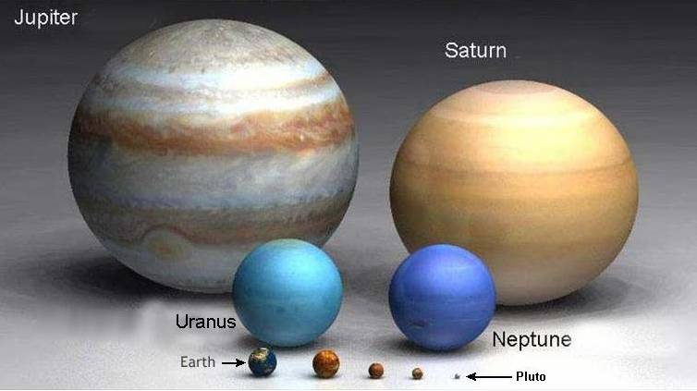
How many Earths will fit in Jupiter?
Notes:
1400 (if you could deform the earths) vs 900 (if earth remained a spheres)

Slide 48
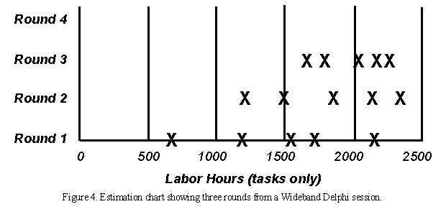
Wide-band Delphi-2
Image is from: http://www.processimpact.com/articles/delphi.html

Slide 49
Parametric (Algorithmic) Models
Formulas that compute effort and duration based on system size and other cost drivers such as capability of developers, effectiveness of development process, schedule constraints, etc.
Most models are derived using regression analysis techniques from large databases of completed projects.
In general the accuracy of their predictions depends on the similarity between the projects in the database and the project to which they are applied.

Slide 50
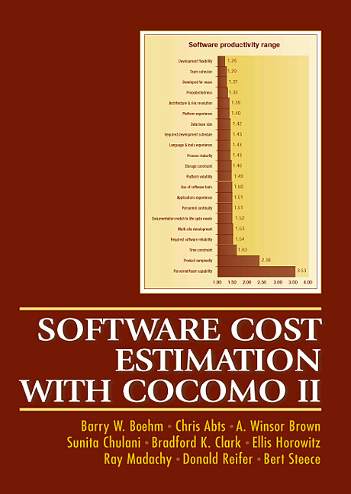

Slide 51
COCOMO II
COCOMO = Constructive Cost Model
Basic formula:
Effort_{person months} = 2.94 * (Cost Drivers) * (KLOC)**E
KLOC = Size estimate
Cost Drivers = project attributes (Effort Multipliers), not a function of program size, that influence effort. Examples: analyst capability, reliability requirements, etc.
E = an exponent based on project attributes (Project Scale Factors) that do depend on program size. Examples: process maturity, team cohesion, etc.
Notes:
Nominal or average values for cost drivers is 1. So, if analysts have average capability you multiple by 1. If they are below average you multiple by a number greater than 1 such as 1.15.
Effort Multipliers vs Project Scale Factors.
COCOMO I formulas were derived from 63 projects at TRW Aerospace.

Slide 52
COCOMO II
Schedule estimate is a function of person months:
Duration_{Months} = 3.67 * (Effort_{person months})**F
F = an exponent based on factors that are effected by scale or size of the program

Slide 53

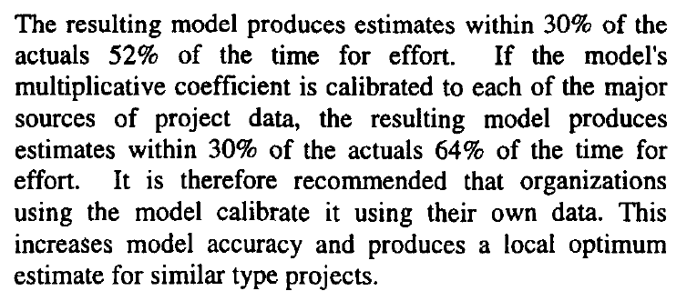
“Probability Distribution” of COCOMO II Estimates
Notes:
Ref: http://delivery.acm.org/10.1145/310000/302218/p477-clark.pdf?key1=302218&key2=0718040621&coll=GUIDE&dl=GUIDE&CFID=67601713&CFTOKEN=89012155

Slide 54
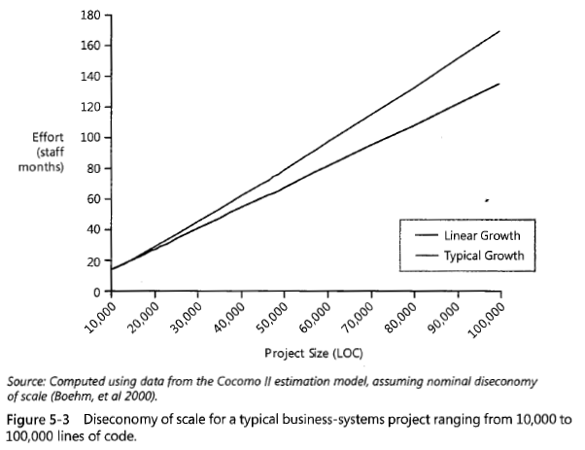
Diseconomy of scale
Notes:
Difference is more pronounced when the range of project sizes is greater.

Slide 55
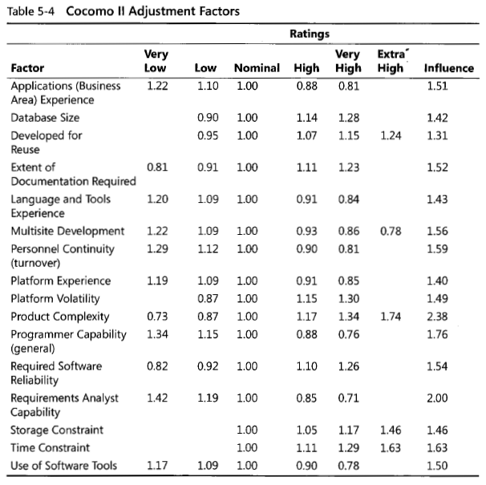
Cocomo cost factors
Notes:
Influence is the range of impact this variable has on effort. It is calculated by dividing the high number by the low number. For example, the influence of product complexity is 2.38 (1.74/.73).

Slide 56
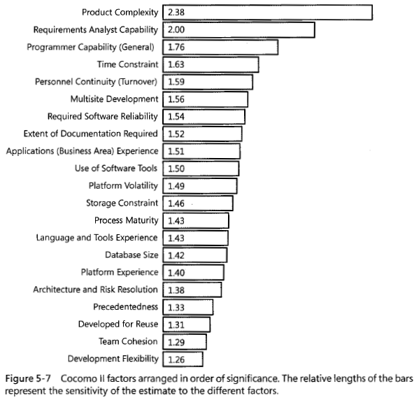
Cocomo cost factors
Notes:
When you combine programmer and analyst capability (as Boehm does in the image on the front of his book) people have the greatest effect on effort estimates (2.0 * 1.76 = 3.52). Is your company paying 4X as much for analysts and programmers in the top percentile as they are for those in the bottom percentile?
This graph and the data behind it lend support to the ideas that:
Software’s Primary Technical Imperative is: Managing Complexity [McConnell CC2]
Software’s Primary Non-Technical Imperative is: Professional Development

Slide 57
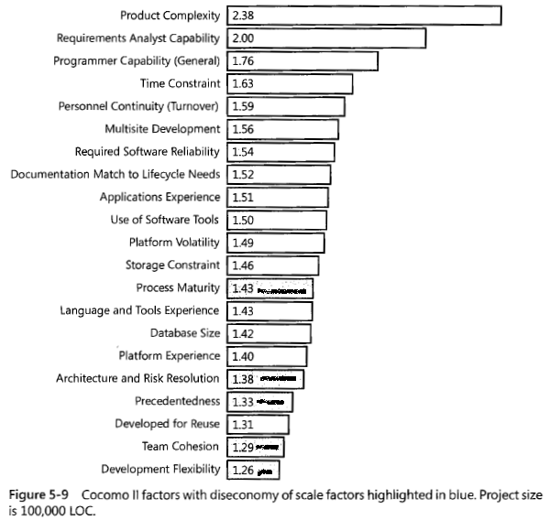
Cocomo cost factors

Slide 58
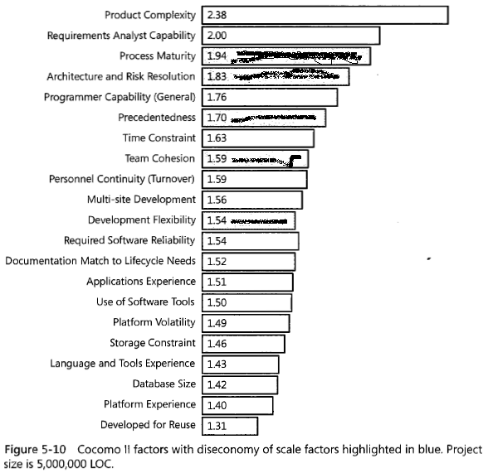
Cocomo cost factors
Notes:
As project size grows, management becomes more important.

Slide 59
Estimation Guidelines
Don’t confuse estimates with targets
Apply more than one technique and compare the results
Collect and use historical data
Use a structured and defined process. Consistency will facilitate the use of historical data.
Update estimates as new information becomes available
Let the individuals doing the work participate in the development of the estimates. This will garner commitment.
Be aware that programmers tend to be optimistic when estimating.
There is an upper limit on estimation accuracy when the development process is out of control.
Notes:
McCall’s Quality model is another example where having domain-specific data improves the accuracy of a quantitative approach.

Slide 60
Psychology of metrics
Notes:
TBD: Psychology of metrics
Describe how metrics and measuring affect the people whose work is being measured and how people affect the ways in which metrics are used and data are gathered.

